Slide 1
Mandli Communications, Inc.
SECTION 1
Company Review
Notes:
Here’s what we have to offer

Slide 2
Mandli Communications, INC.
Established in 1983
Based in Fitchburg, WI
170+ experienced team members
Worked with 30+ DOTs
Collected Data in all 50 states
First pavement collection in 2002
INTERSECTION MODELING
PAVEMENT
ASSET INVENTORY
ASSET ENCROACHMENT
RIGHT-OF-WAY IMAGING
CURVE & GRADE

Slide 3
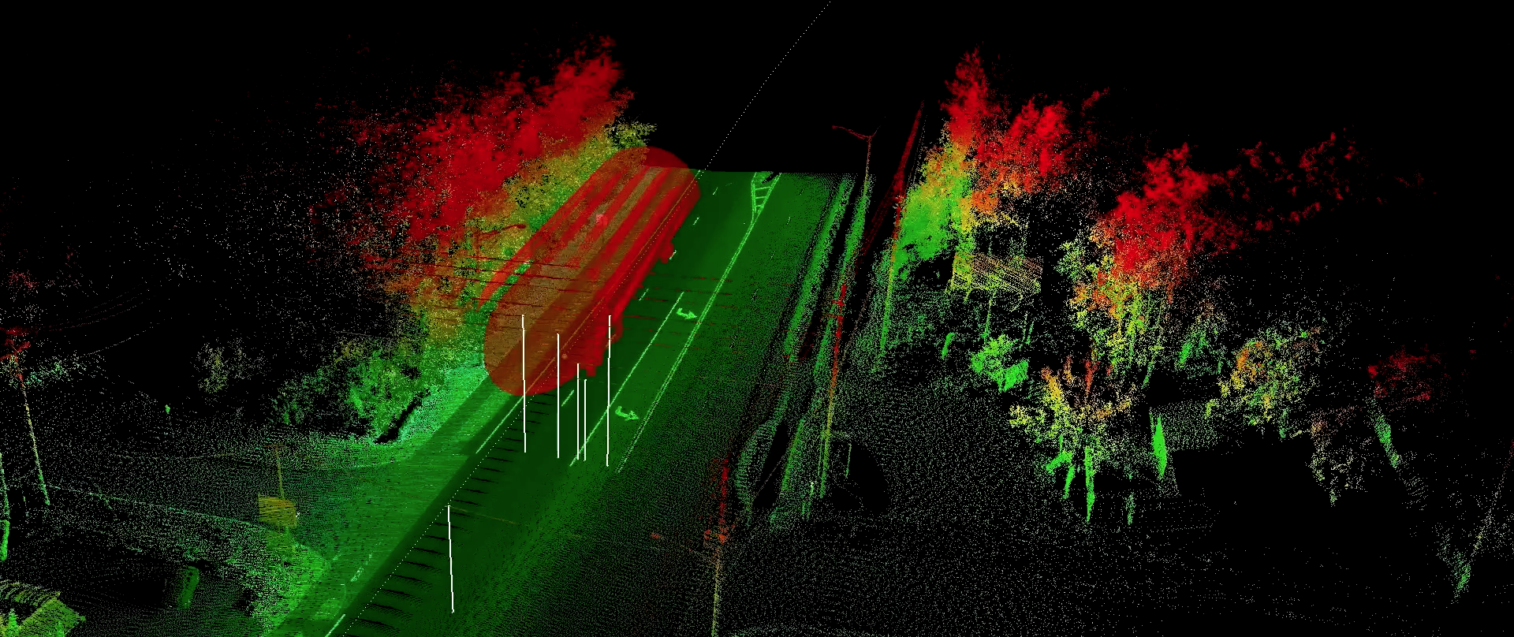
Wings of Dreams Project
Notes:
We’ve been here many times and have a lot of experience with the Florida DOT

Slide 4
MILES COLLECTED
113,873
107,569
89,207
93,570
84,157
83,146
76,912
55,481
47,303
2010
2011
2012
2013
2014
2015
2016
2017
2018
Over 750,000 Miles
Notes:
To date, 2019 mileage a 97796

Slide 5
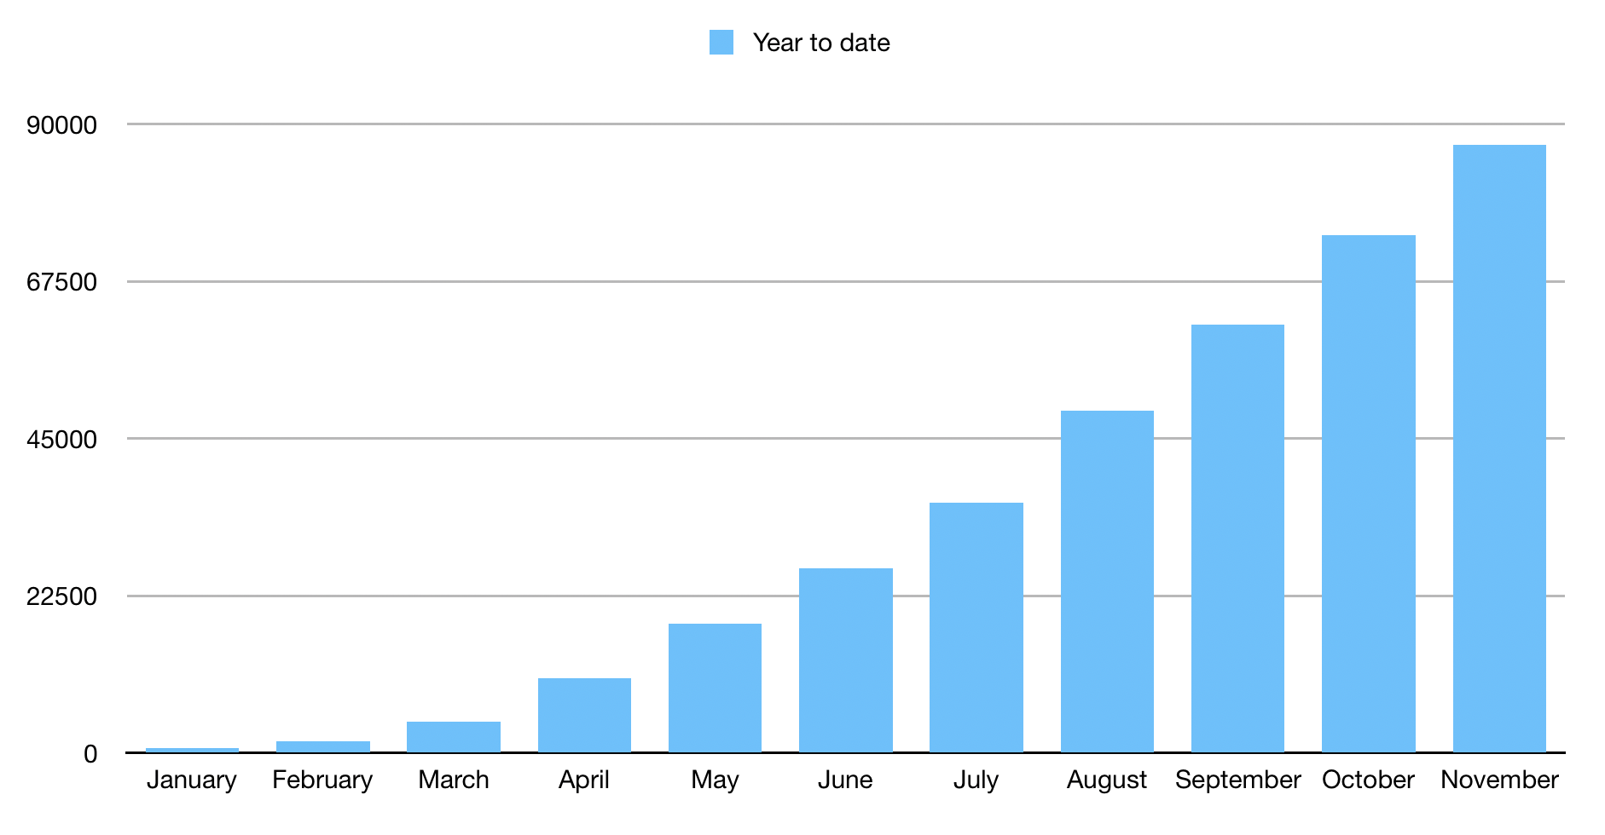
MILES COLLECTED 2019
12969
12785
12316
87052
13213
9298
8034
7744
cumulative
6220
912
2821
733
*500 more in December in Hawaii
Notes:
To date, 2019 mileage a 97796

Slide 6
SMALL BOX SOLUTION

Slide 7
MAVERICK
LiDAR Velodyne HDL-32
700,000 points/second
+/- 2 cm accuracy
100 meter range
360 Degree Imaging
30 megapixels
Customizable interval
90% full sphere FOV
Positional
Provides precise location data
+/- 1 meter accuracy
Integrated IMU

Slide 8
LiDAR
2 Velodyne HDL 32 sensors
100 meter range
1.4 million points per second
360˚ coverage
Minimal shadowing

Slide 9
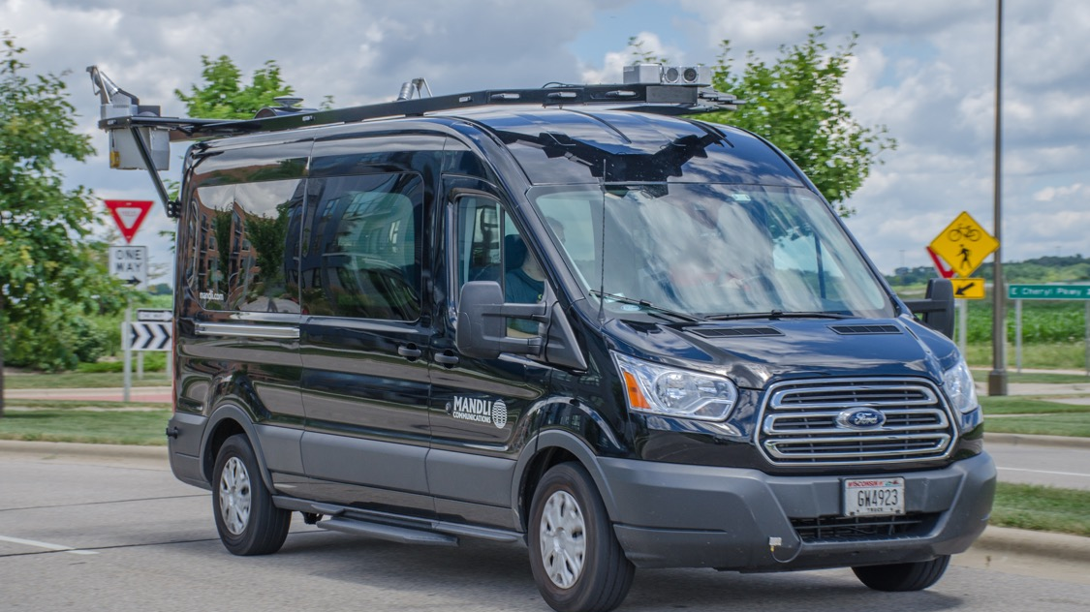
X-35 Vehicles
Notes:
add in additional slides

Slide 10
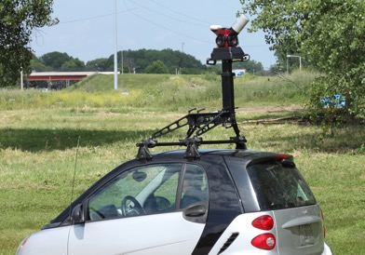
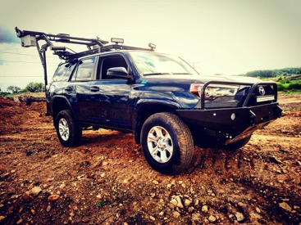
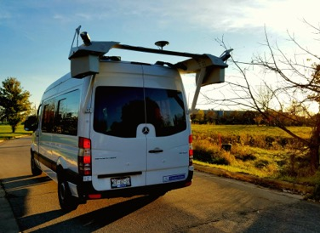
Hardware Solutions
Imaging
LiDAR
Pavement

Slide 11
Camera System: Automated Control
X35 image capture employs auto-exposure, auto-white balance, and auto-gain controls to provide maximum responsiveness in dynamic lighting conditions.
Removes the need for human decision making

Slide 12
Imaging
High Resolution
Excellent Zoom Capability
Monitors images in real-time
RESOLUTION
4096 × 2160
FRAME PER MILE
100 to 500
COLLECTION SPEED
UP TO 65 MPH

Slide 13
LCMS Capabilities
High-speed camera optics
Laser line projectors to acquire 2D images and high-resolution 3D profiles
Automatic detection of cracks and other road surface features
Operates in all lighting conditions
Detects various pavement types
Measured at speeds up to 65 mph on roads reaching 4m wide

Slide 14
Laser Crack Measuring System
Collects rutting and transverse profiles, distress, faulting, roughness, and pavement imaging​
Scanned area collected by single-point lasers
Automated distress detection
​Acquires both 2D images and high-resolution 3D profiles of the road​​
Detection of pavement type​
Scanned area collected by the LCMS
​4,000 point rutting and faulting​

